Slide 1
Simple is Best
The journey of taking over mobile system using a GPU logical bug
Shang Hongze
Dawn Security Lab

Slide 2


About Me
Shang Hongze
Security Researcher from Dawn Security Lab, JD.com, Inc.
CTF Player, DEFCON CTF Winner 2020
Bug Hunter on Android, IoT, Windows…
@hzshang15
Mobile security research and defense, anti AD fraud & Bots
Pwnie Award Best Privilege Escalation Award 2022
@dawnseclab

Slide 3
Agenda
01
The Background: why do we need the root
02
Introduction of Android GPU
03
Bug hunting and exploitation of Huawei Kirin SoC
04
DEMO show

Slide 4
Why do we need the root?
It’s pretty COOL! Bug hunt and get a big bounty
Control everything, debuging, developing
See everything…
Anti Mobile Ad fraud
Traffic hijacking
Traffic misdirection
Robot clicks
…

Slide 5
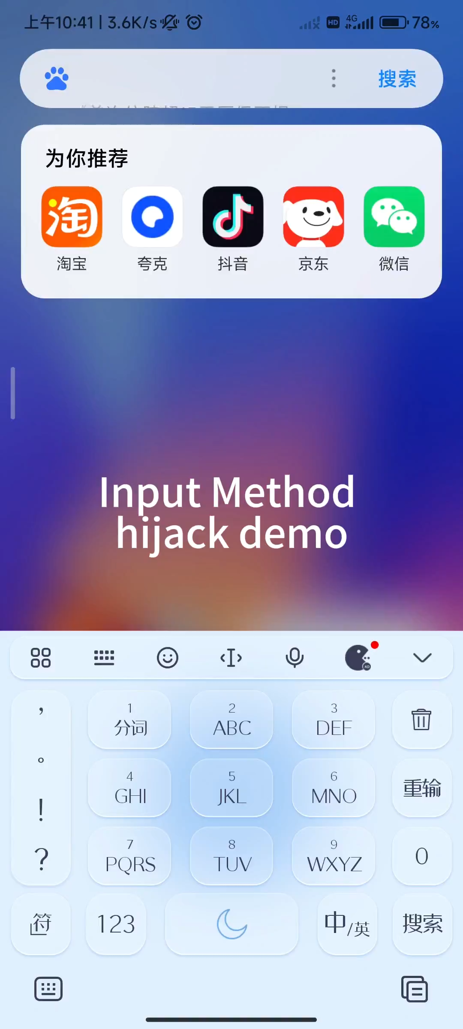
Why do we need the root?
When we have root:
Breakthrough the sandbox protection
Locate evidence of cheating in malicious apps and ROMs from test device
access the app local files, In-Memory config…
traffic hijack case

Slide 6
02 Introduction of Android GPU

Slide 7
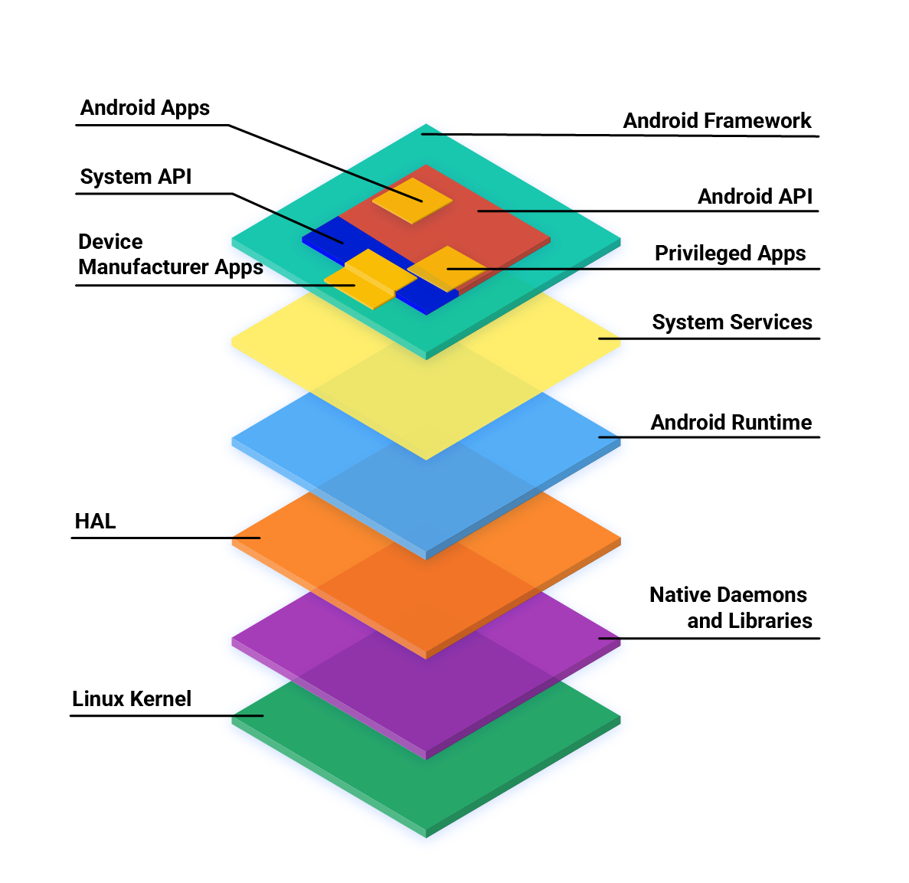
Introduction of Android GPU
Android Framework
APP Level Runtime provider, permission control…
Linux
Process Level Runtime provider
HAL
Hardware abstraction layer
An unified interface for different hardware
Shared User Library + Kernel Module (a.k.a KMD)
Android ≈ Framework + Linux + HAL

Slide 8



Introduction of Android GPU
Normal GPU rendering example
Dynamic Link
ioctl / mmap
Lookup the libGLESv2.so libvulkan.so in system ROMs.
Expose the functions with consistent names, but the internal implementation is written by the vendor.
Kernel module
register character devices like “/dev/kgsl-3d0”, “/dev/mali0”
Plenty Kernel code written by the vendor.
Ring 3 World
Ring 0 World

Slide 9
Introduction of Android GPU
Innormal GPU rendering example
Dynamic Link
ioctl / mmap
Illegal ioctl / mmap sequence
Ring 3 World
Ring 0 World

Slide 10
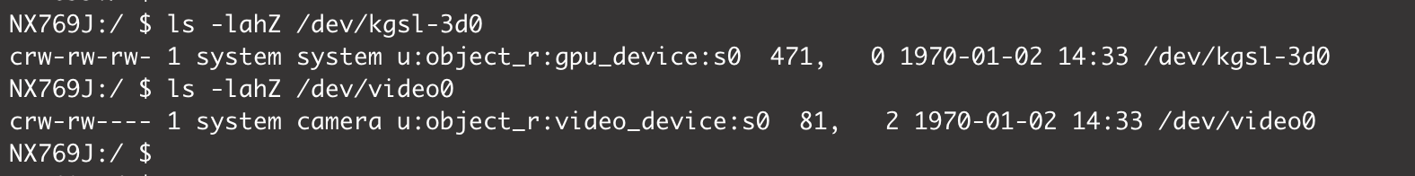
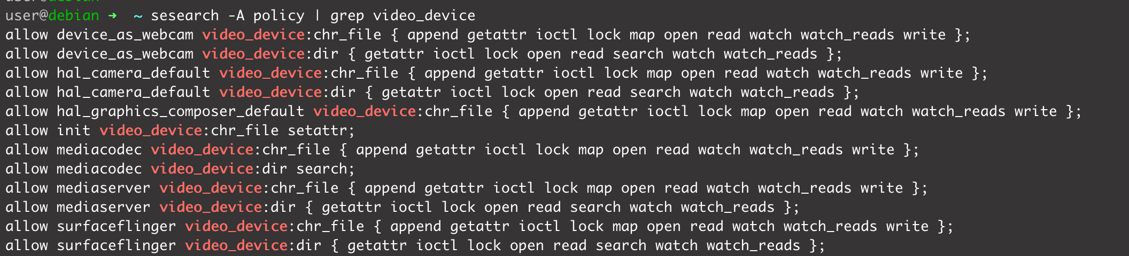
Introduction of Android GPU
Android Security Protection for HAL code
Limit the character device file permission
SeLinux restriction
Only system app can access camera

Slide 11
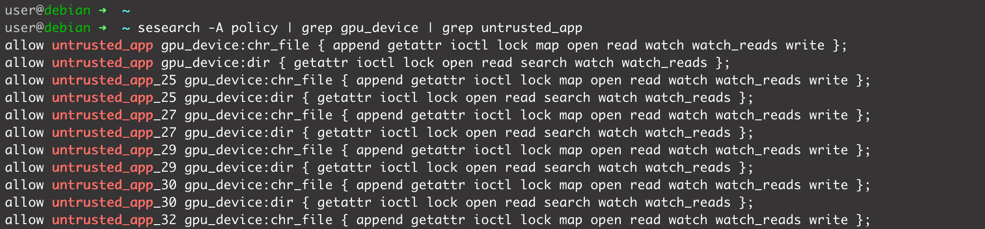
Introduction of Android GPU
Android Security Protection for HAL code
Limit the character device file permission
SeLinux restriction
But GPU device is accessable for everyone

Slide 12
Introduction of Android GPU
Android Exploit in the wild
CVE-2022-22706 / CVE-2021-39793: Mali GPU driver makes read-only imported pages host-writable | GPU
CVE-2023-20963: Android: mismatching parcel/unparcel logic for WorkSource | Parcel Mismatch
CVE-2023-33106: Qualcomm Adreno GPU KGSL_GPU_AUX_COMMAND_SYNC OOB | GPU
CVE-2023-33107: Qualcomm Adreno GPU KGSL_IOCTL_GPUOBJ_IMPORT integer overflow | GPU
CVE-2023-4211: Use-after-Free in ARM Mali GPU Driver | GPU
https://googleprojectzero.github.io/0days-in-the-wild/rca.html
GPU is the weakest component in Android security ecosystem!

Slide 13
03 Bug hunting and exploitation of Huawei Kirin SoC

Slide 14
Bug hunting and exploitation of Huawei Kirin SoC
The Target
Huawei Mate60 Pro
Launched in August 2023
Kirin 9000S SoC
kernel driver is open source
https://consumer.huawei.com/en/opensource/
device char file /dev/hvgr0
No public vulnerability reports！

Slide 15
Bug hunting and exploitation of Huawei Kirin SoC
Kirin GPU Memory Management
Similar with Mali GPU KMD
int gfd = open(“/dev/hvgr0”, O_RDWR); // 【1】create a new GPU context
hvgr_ioctl_para_drv_cfg args;
memset(&args, 0, sizeof(args));
args.mem_replay_size = 0;
ioctl(gfd, HVGR_CFG_CONFIG, &args); // 【2】 init GPU configuration
#define PAGESIZE (1024L * 1024L * 1024L)
hvgr_ioctl_para_alloc_memory args_alloc;
args_alloc.in.pages = 0;
args_alloc.in.max_pages = PAGESIZE >> 12;
args_alloc.in.attribute = HVGR_MEM_ATTR_GPU_RD | HVGR_MEM_ATTR_GPU_WR | HVGR_MEM_ATTR_GROWABLE | HVGR_MEM_MASK_UMD_ACCESS;
args_alloc.in.va = 0;
args_alloc.in.property = HVGR_MEM_PROPERTY_SAME_VA;
ret = ioctl(gfd, HVGR_MEM_ALLOC, &args_alloc); // 【3】alloc a GPU memory with specific property and attribute

Slide 16
Bug hunting and exploitation of Huawei Kirin SoC
Kirin GPU Memory Management
GPU Memory Property List | Function
HVGR_MEM_PROPERTY_GPU_MEM | Alloc normal GPU memory
HVGR_MEM_PROPERTY_SAME_VA | Alloc normal GPU memory, mmap it to CPU process
HVGR_MEM_PROPERTY_4G_VA | Alloc a specific GPU memory with 4G size
HVGR_MEM_PROPERTY_2M_PAGE | Alloc a GPU memory, align the GVA with 2M, it will be allocated from an isolated memory pool
HVGR_MEM_PROPERTY_REPLAY | GPU memory for profiling and debugging
HVGR_MEM_PROPERTY_SPARSE | Special memory for sparse matrix
HVGR_MEM_PROPERTY_JIT | GPU Code Memory
HVGR_MEM_PROPERTY_DRIVER | Memory related to GPU drivers
HVGR_MEM_PROPERTY_IMPORT | Import userspace CVA memory to GPU
HVGR_MEM_PROPERTY_ALIAS | Mmap a GPU memory with new GVA
GVA:
GPU Virual Memory
CVA:
CPU Virtual Memory
PA:
Physical Memory

Slide 17
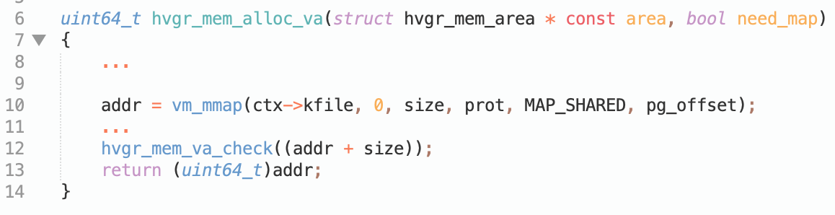
Bug hunting and exploitation of Huawei Kirin SoC
Kirin GPU Memory Management
To ensure that GPU virtual memory areas does not overlap
1. Use a RBTree to maintain GPU memory block list
Qualcomm Snapdragon
Mali
2. Use Linux System Virtual Memory Management APIs
Kirin
GPU RW only memory
prot &= ~(VM_READ|VM_WRITE)
GPU and CPU shared RW memory
prot |= (VM_READ|VM_WRITE)

Slide 18
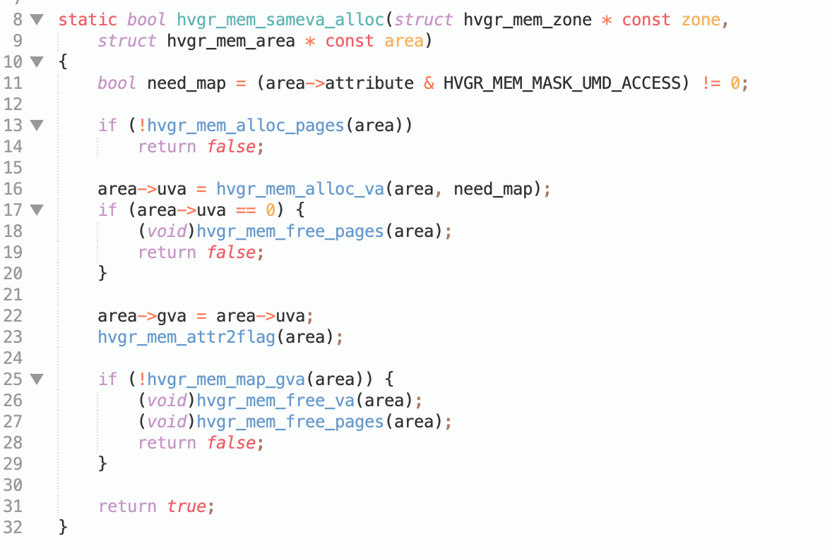
Bug hunting and exploitation of Huawei Kirin SoC
GPU SAME_VA alloc function review
【1】alloc physical pages
【2】alloc new vma entry using vm_mmap,
setup CPU pagefault callback
【3】setup GPU page table

Slide 19
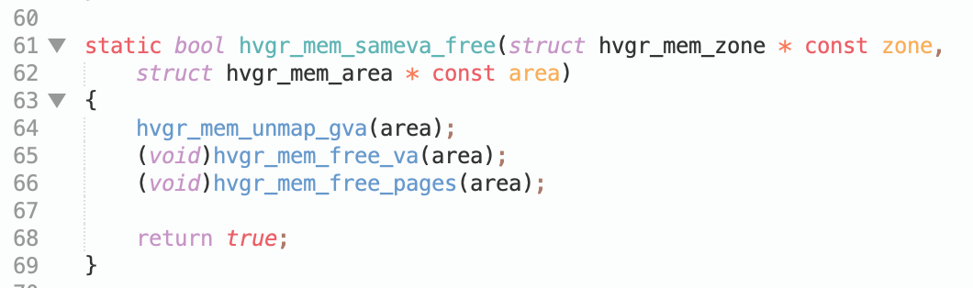
Bug hunting and exploitation of Huawei Kirin SoC
GPU SAME_VA free function
【1】clear GPU page table
【2】call vm_munmap to release vma entry
【3】release physical pages
???
ignore the return value

Slide 20
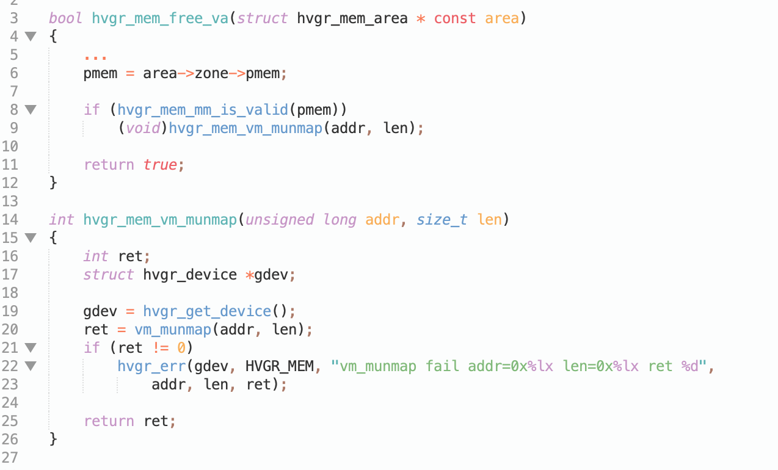
Bug hunting and exploitation of Huawei Kirin SoC
GPU SAME_VA free function
hvgr_mem_sameva_free
> hvgr_mem_free_va
> hvgr_mem_vm_munmap
> vm_munmap
ignore the return value

Slide 21
Bug hunting and exploitation of Huawei Kirin SoC
What if the vm_munmap(addr,length) failed?
CPU PTE entry is not clear
physical page have been freed
PAGE UAF?
How to make vm_munmap(addr,length) failed???
Case 1 invalid address or length
Case 2 trigger the a vma split event if the address range is misaligned, then goto fail
total vma count > max_map_count (/proc/sys/vm/max_map_count) 65535
Conflict with flag VM_DONTEXPAND
But the GPU memory address always is the range of the VMA.
Impossible to trigger vm_munmap failed???

Slide 22
Bug hunting and exploitation of Huawei Kirin SoC
One more thing
Kernel Mode | User Mode
vm_mmap | mmap
vm_munmap | munmap
We can always use munmap syscall to release any memory segment, including the GPU memory blocks
alloc GPU Memory using ioctl
release memory vma entry using munmap
release GPU memory using ioctl
vm_munmap does return false!
But CPU PTE entry is cleared ☹
No more page UAF

Slide 23
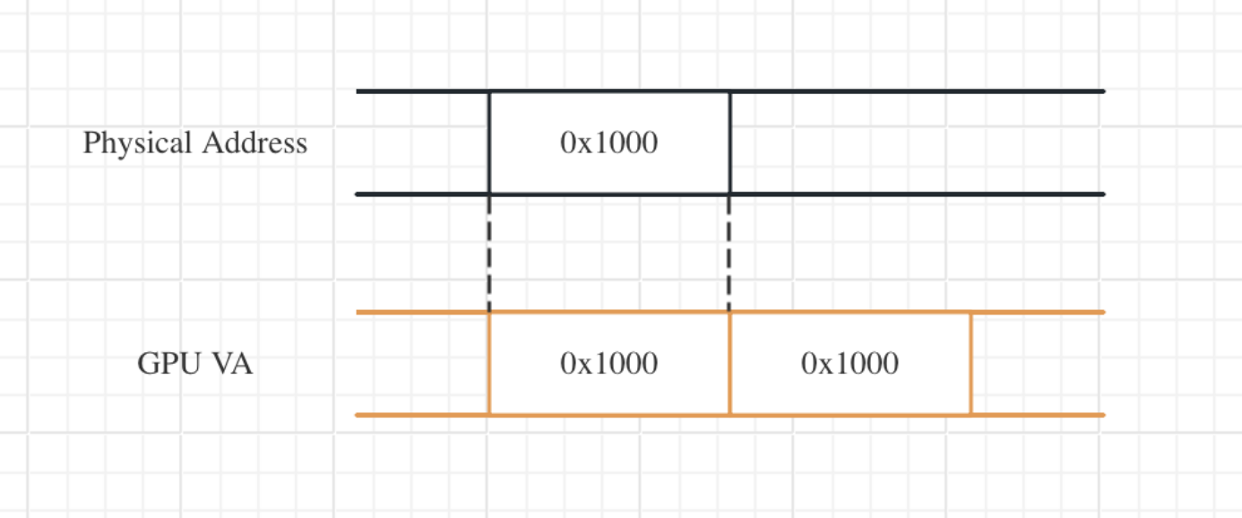
Bug hunting and exploitation of Huawei Kirin SoC
Rewrite CPU Page Table Entry
alloc new GPU memory example
hvgr_ioctl_para_alloc_memory args_alloc;
args_alloc.in.pages = 1; // GPU real physical pages
args_alloc.in.max_pages = 2; // GPU virtual memory size
args_alloc.in.attribute = HVGR_MEM_ATTR_GPU_RD | HVGR_MEM_ATTR_GPU_WR | HVGR_MEM_ATTR_GROWABLE | HVGR_MEM_MASK_UMD_ACCESS;
args_alloc.in.va = 0;
args_alloc.in.property = HVGR_MEM_PROPERTY_SAME_VA;
ret = ioctl(gfd, HVGR_MEM_ALLOC, &args_alloc);
args_alloc.in.pages = 1
args_alloc.in.max_pages = 2

Slide 24
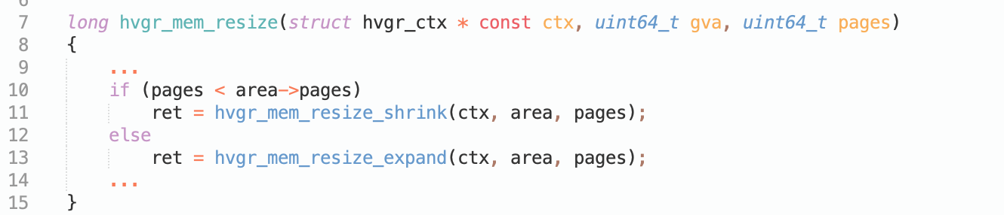
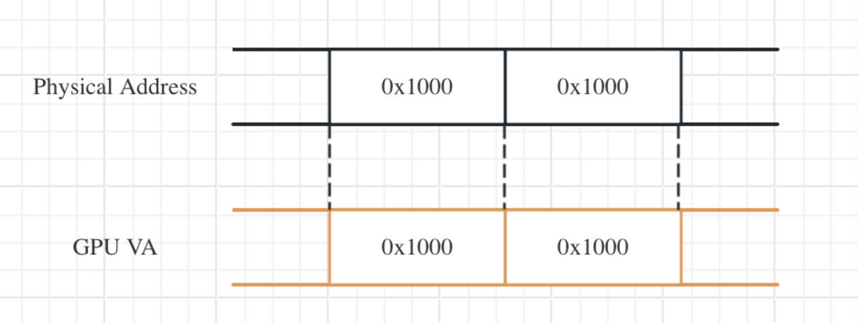
Bug hunting and exploitation of Huawei Kirin SoC
Rewrite CPU Page Table Entry
resize function
1. alloc new physical memory
2. setup GPU PTE
3. setup CPU PTE if mapped in userspace

Slide 25
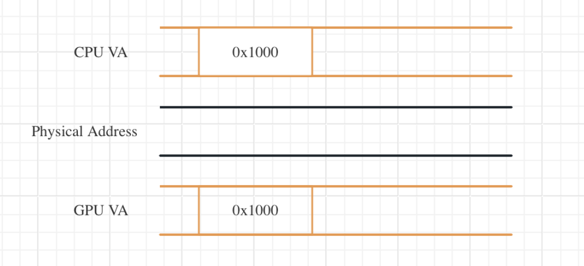
Bug hunting and exploitation of Huawei Kirin SoC
Put it all together
alloc GPU Memory using ioctl
args_alloc.in.pages = 0
args_alloc.in.max_pages = 1

Slide 26
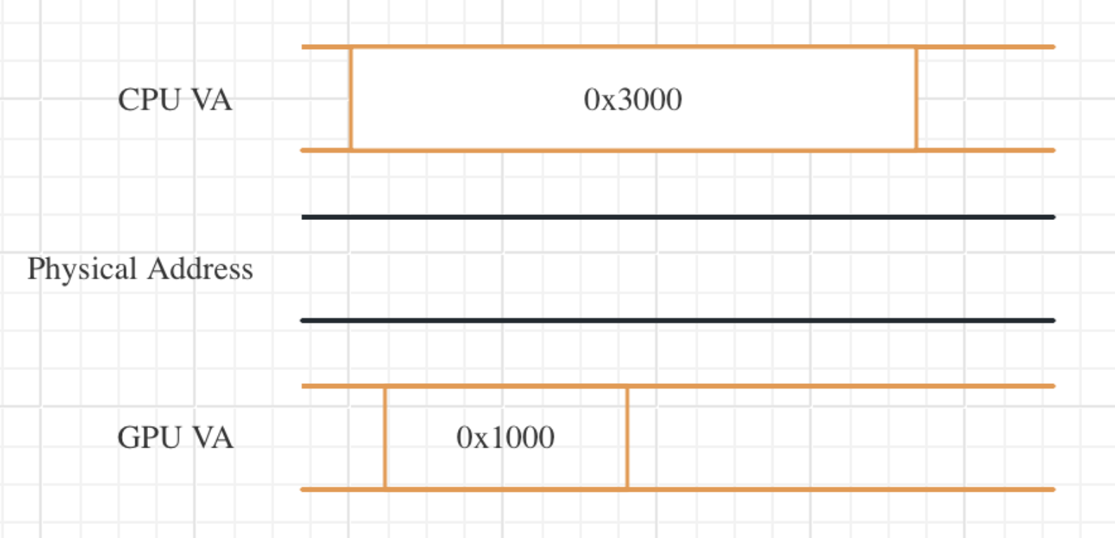
Bug hunting and exploitation of Huawei Kirin SoC
Put it all together
2. munmap CPU VA, mmap a new larger memory segment, covering the GPU VA range

Slide 27
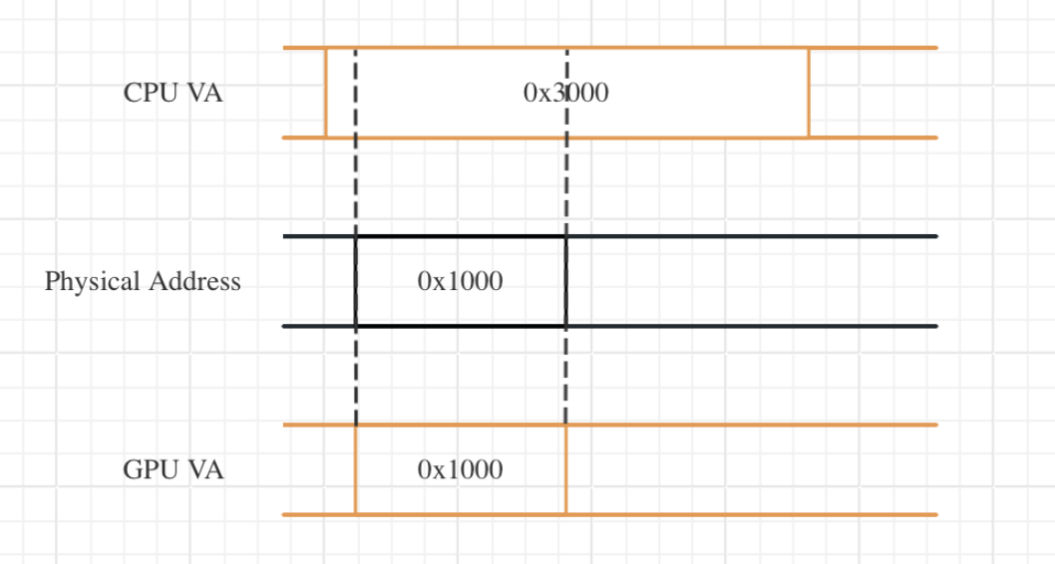
Bug hunting and exploitation of Huawei Kirin SoC
Put it all together
3. call resize function for allocing a new physical page
GPU PTE and CPU PTE will be filled

Slide 28
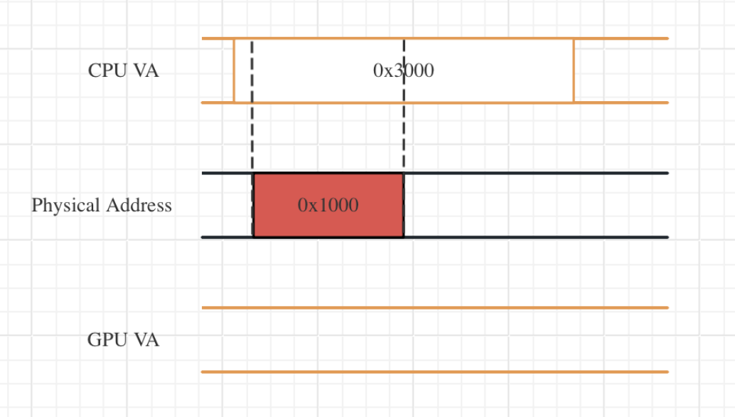
Bug hunting and exploitation of Huawei Kirin SoC
Put it all together
4. free the GPU memory block, trigger vm_munmap(addr, 0x1000) failed
true
false
true
PAGE UAF!

Slide 29
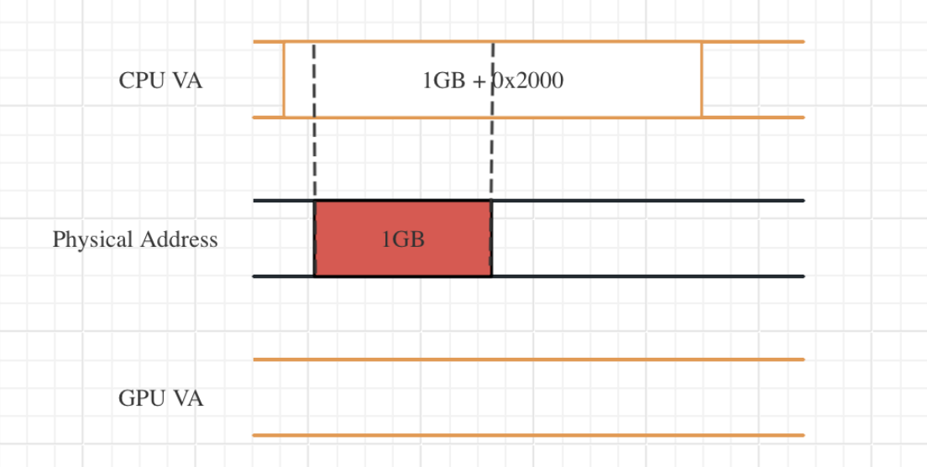
Bug hunting and exploitation of Huawei Kirin SoC
Put it all together
5. make it fast and stable
spray CPU PTE page
read and write arbitrary PA using KSMA
search kernel text from 0x10000
Rewrite system RO file page cache

Slide 30
Bug hunting and exploitation of Huawei Kirin SoC
What can we do?
Rewrite “run-as” binary, switching to other users
Inject shellcode to privileged process
BUT
HKIP still works!!!
We can’t disable SeLinux
Patching the kernel text code will crash the system

Slide 31
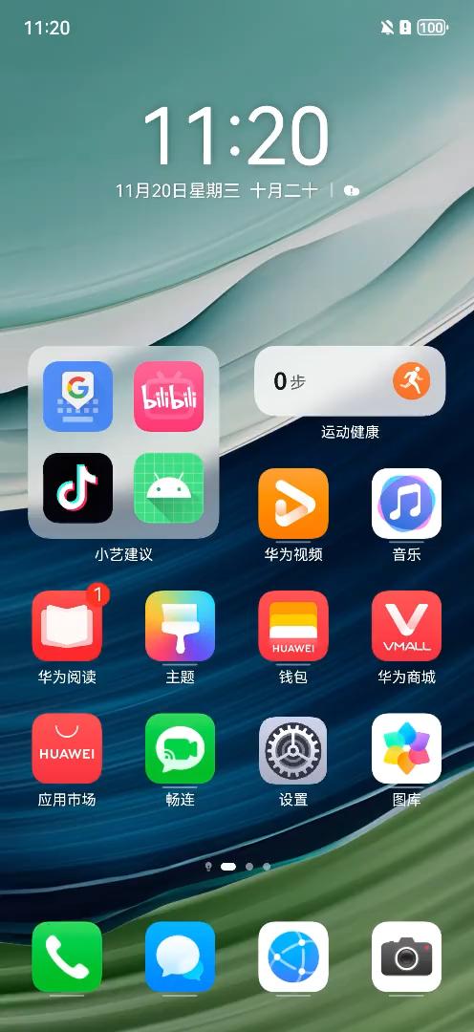
DEMO show
Huawei Mate60 Pro
Security Patch Date 2024/4/1

Slide 32
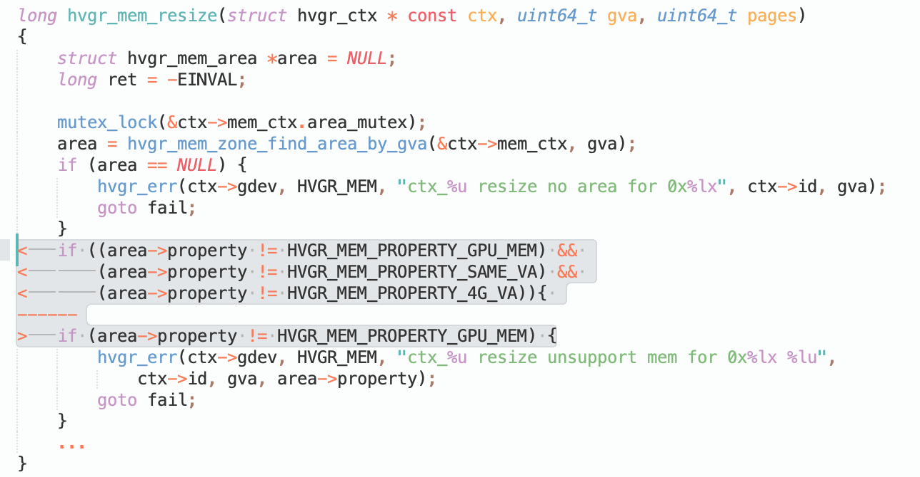
How Huawei fixed it
munmap still works
We can not rewrite CPU PTE after munmap
No More Page UAF
Disable resize function for CPU shared memory

Slide 33
Q&A

